Slide 1
Lecture 10
Transactions and transaction processing

Slide 2
Transaction processing
Two basic requirements for DBMS:
protect data – in terms of resistance to various server crashes
provide fair, fast, and asynchronous access to multiple concurrent users.
Solution
concurrency control component
recovery component

Slide 3
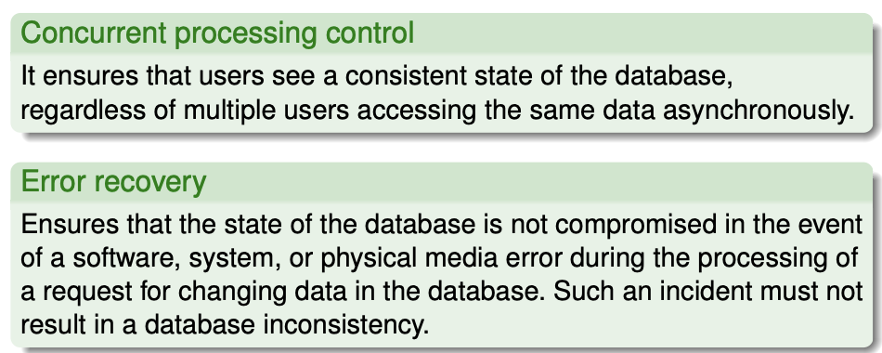
Transaction processing

Slide 4
Transaction processing
Solution is a transaction:
a suitable unit of work and appropriate mechanisms to ensure that the database remains consistent after the end of the action (correct and incorrect) (all ICs defined in the schema are valid).

Slide 5
Modules of RDBMS
RDBMS must guarantee:
Transparent parallel processing of transactions.
Atomicity regarding failures.

Slide 6
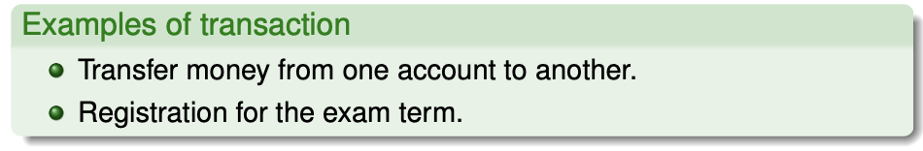
How should we understand the term Transaction?
Suitable “logical” unit of work.
Usually consists of several (or many) operations.

Slide 7
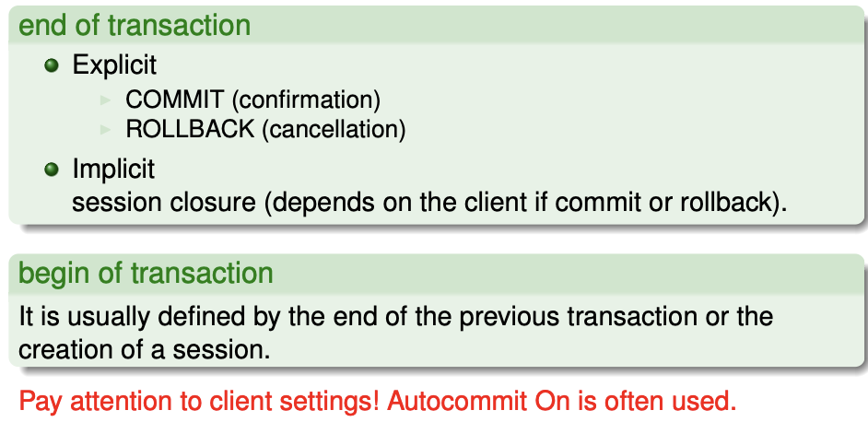
Begin and end of transaction
Transaction boundaries:

Slide 8
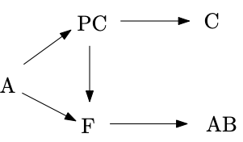
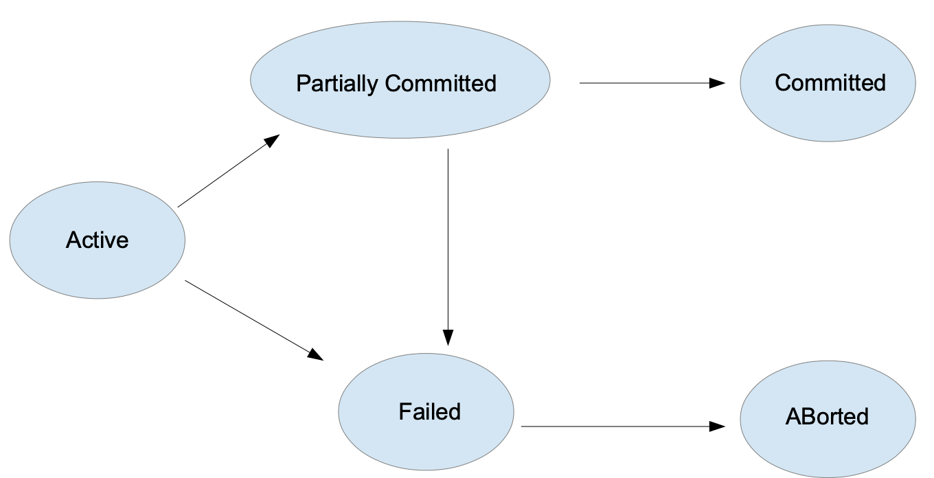
Transaction state diagram
Active – from the beginning (running DML commands)
Partially Committed – after performing the last transaction operation
Committed – after successful completion, ie after confirmation of the COMMIT operation
Failed – the normal running of the transaction cannot be continued
ABorted – after the end of the ROLLBACK operation, ie putting the database in the state before the start of the transaction

Slide 9
Transaction properties – ACID
ACID transaction properties:
(Atomicity) – the transaction must take place as a whole or not at all,
(Consistency) – the transaction transforms the database from one consistent state to another consistent state,
(Independence) – partial effects of one transaction are not visible to other transactions,
(Durability) –effects of successfully completed (confirmed) transactions are permanently saved (persistence).

Slide 10

Database recovery after a crash
Transaction journal is used (log file).
Transaction log contains “change vectors”
The information from the trace log is used by only to recover the database after an error. Other data structures are used for the ROLLBACK operation and the read consistency guarantees.

Slide 11
Modules and structures used for recovery
database buffer cache
journal contains a sequence of change vectors <transID, blockID, old data, new data>
special change vectors for operations – commit, rollback, checkpoint
checkpoint, checkpoint number (System Change Number - SCN)
The journal and associated structures enable the implementation of Atomicity and Durability in transaction processing.

Slide 12
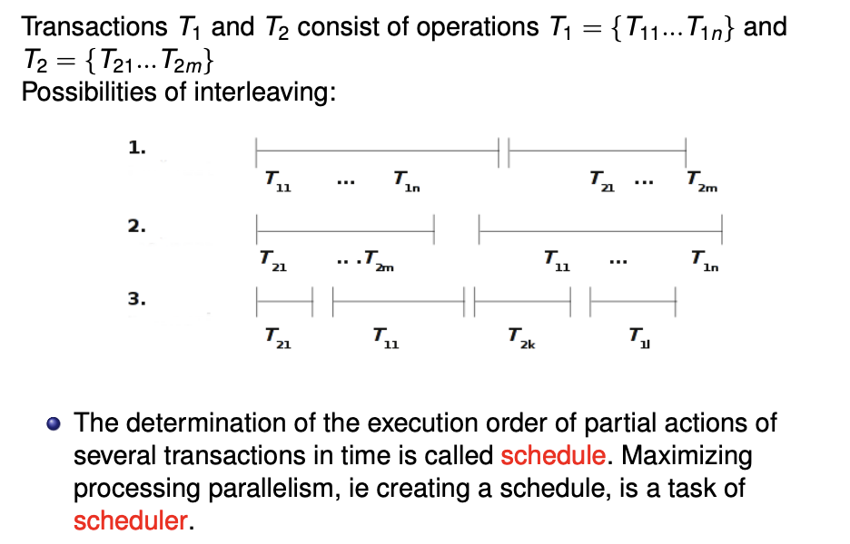
Interleaving transactions, schedule, scheduler

Slide 13
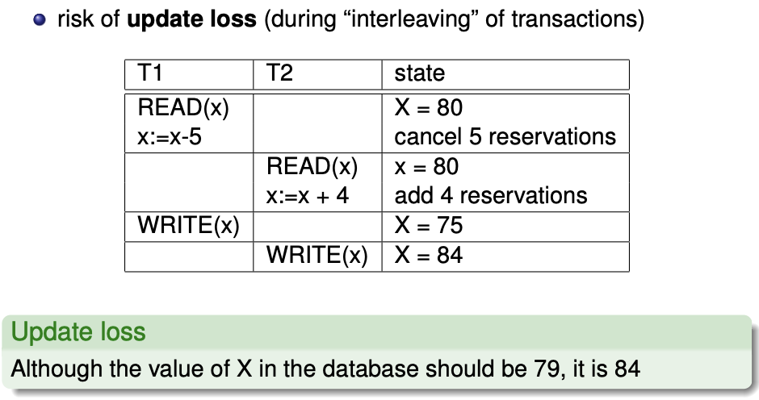
Update loss

Slide 14
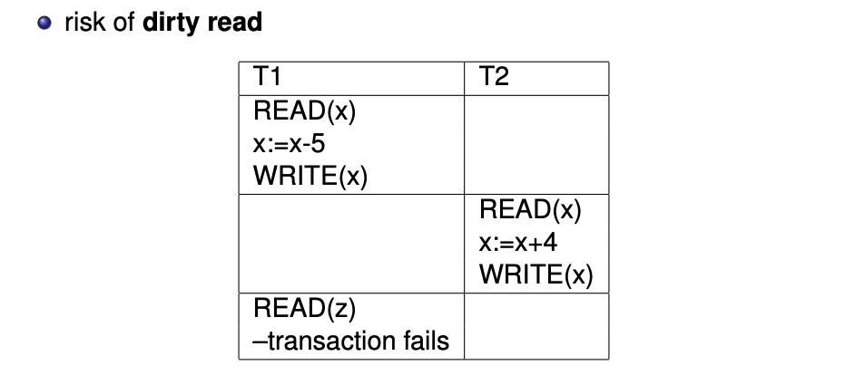

Dirty read
Transaction error

Slide 15
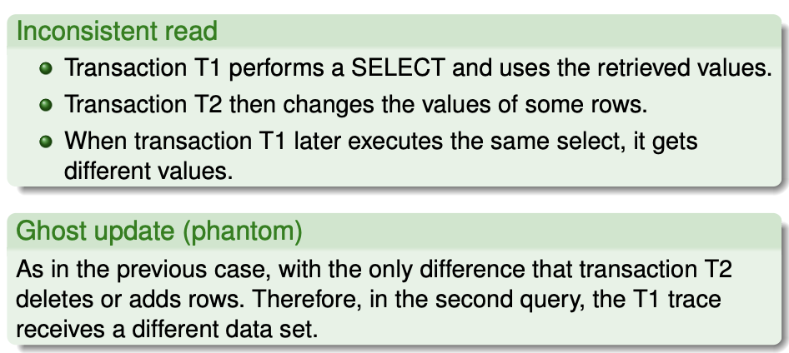
Problems with parallel processing

Slide 16
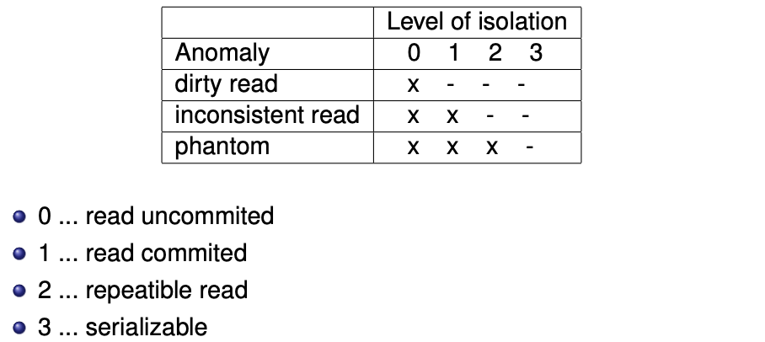
Levels of isolation

Slide 17
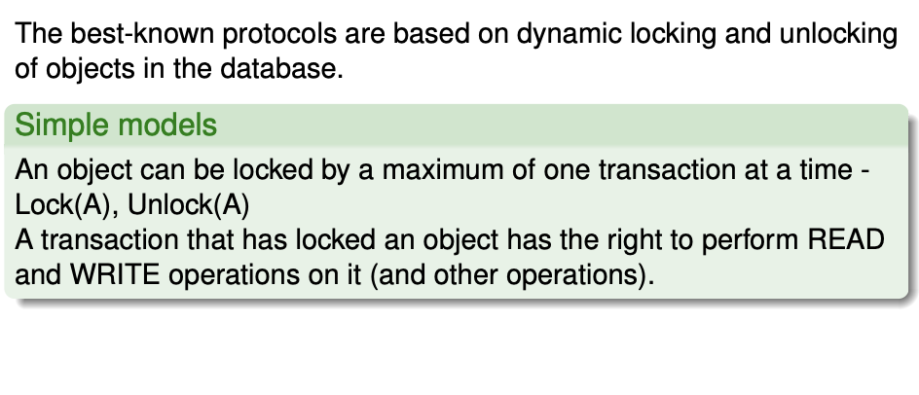
Locking protocols

Slide 18
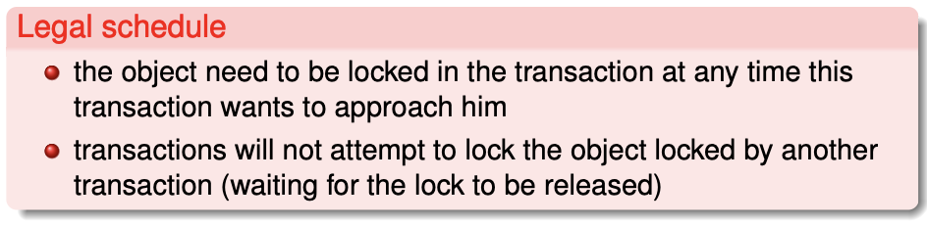
Legal schedule

Slide 19
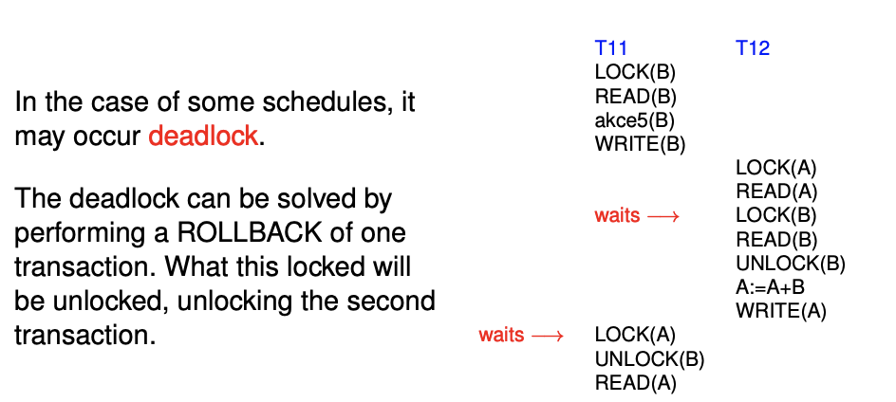
Transaction deadlock

Slide 20
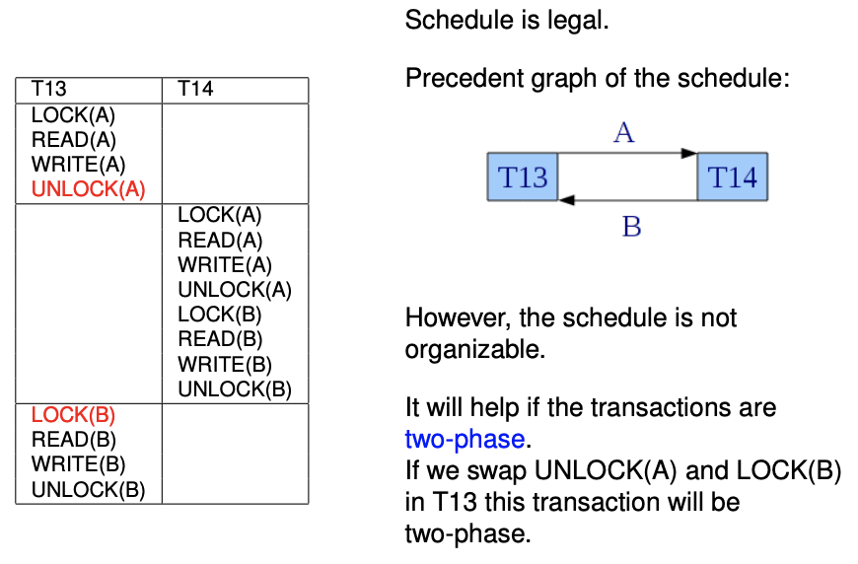
Motivation for Two Phase Locking Protocol

Slide 21
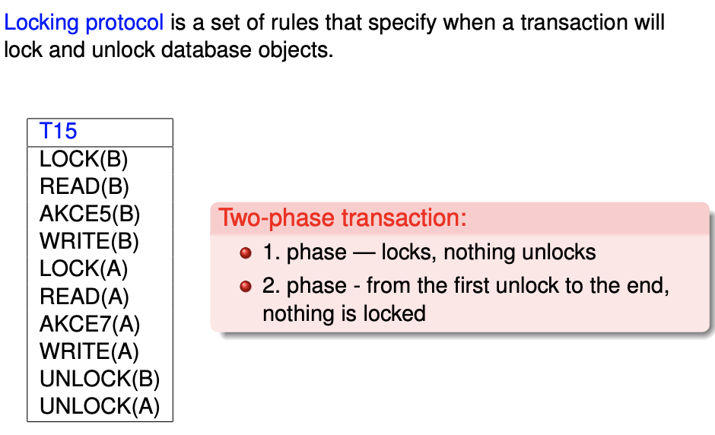
Two Phase Locking Protocol

Slide 22
Concurrent processing – summary
A two-phase locking protocol, legal schedules, and well-formed transactions address the independence of transaction and concurrent work of multiple users over the same data.
Levels of isolation? Different types of locks.
Strict two-phase locking protocol - everything is unlocked at the end of the transaction. Where has concurrent processing gone? Why does it work in total? Locking (usually) at the row level (the whole table can also be locked). More complex structures in other DB models (trees, graphs)?
Atomicity and Durability properties are provided by a journal and associated infrastructure.
The Consistency property is provided directly in the internal algorithms of DML operations and by the fact that a transaction can contain multiple DML and SELECT statements.

